Slide 1
Hypothesis testing
for Taxi-Fare
presented by-
prajakta menkudale

Slide 2
Agenda
Problem Statement
Research Question
Data Overview
Methodology
Analysis and Findings
Hypothesis Testing
Recommendations

Slide 3
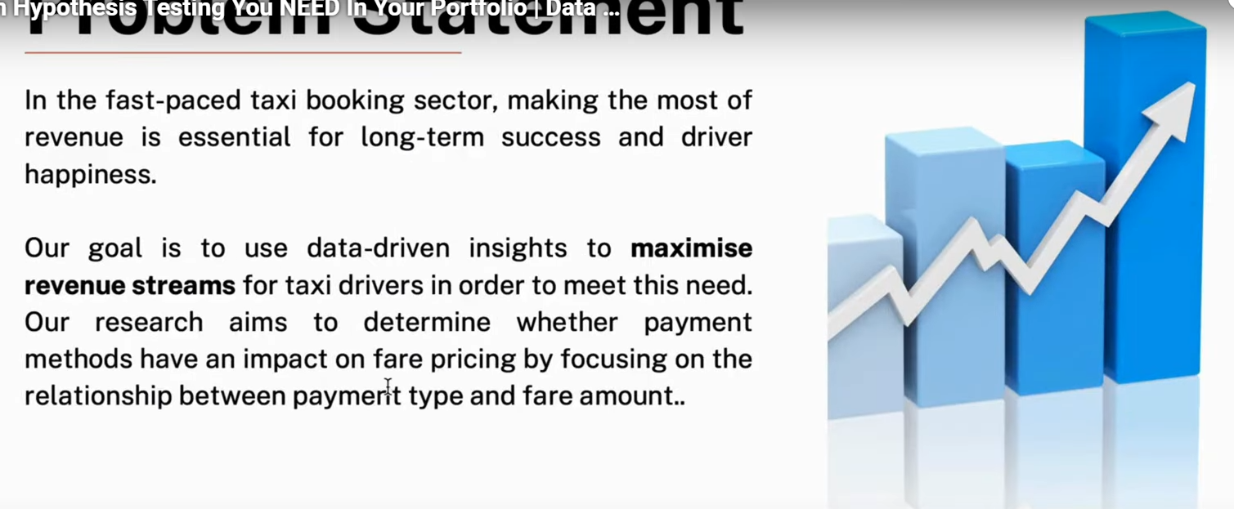
Problem statement

Slide 4
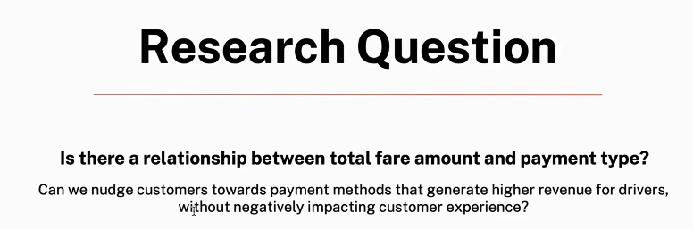

Slide 5
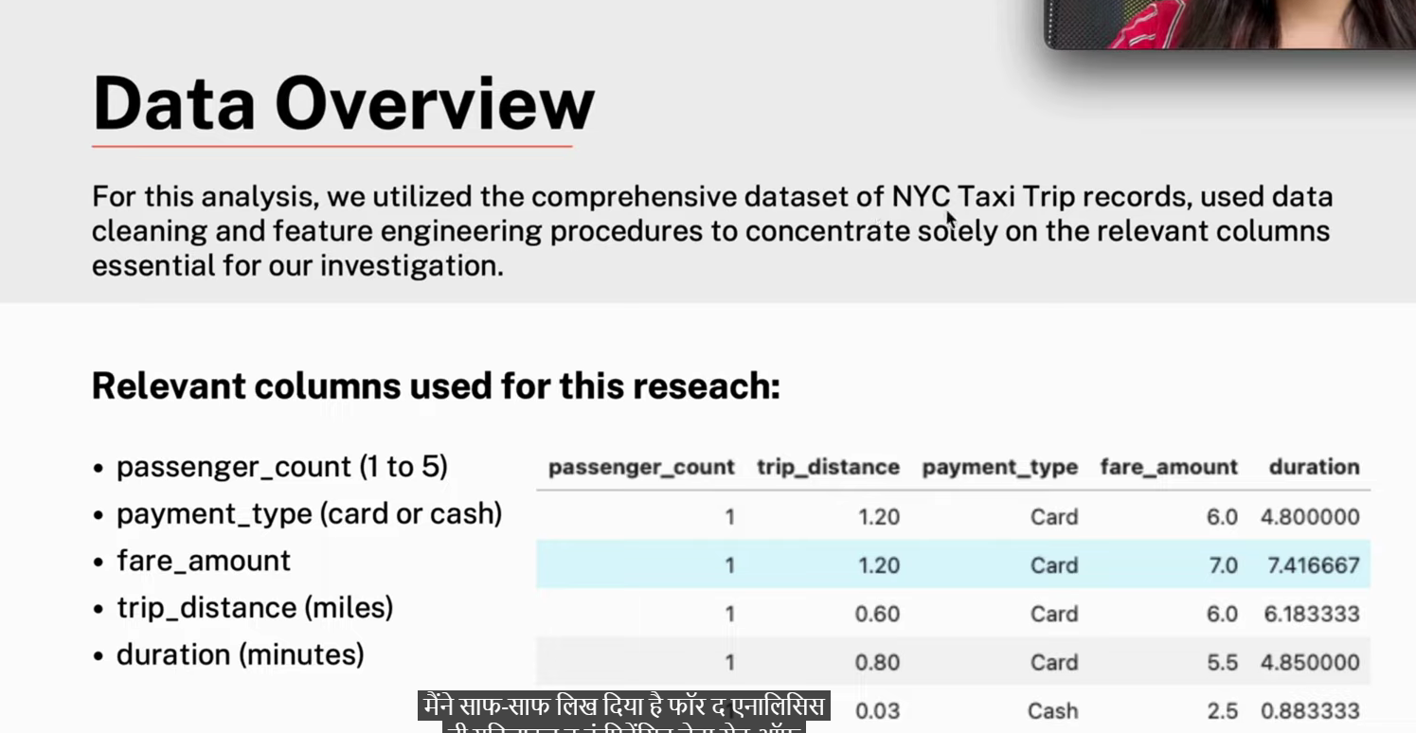

Slide 6
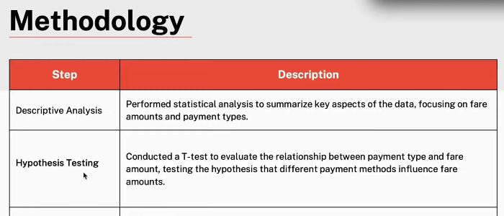

Slide 7
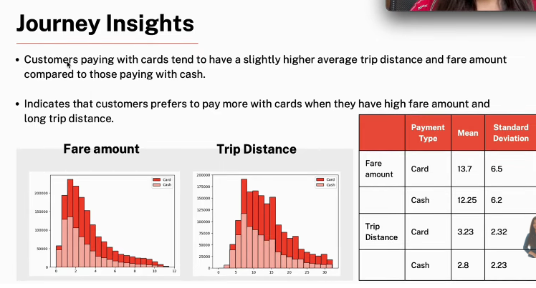

Slide 8
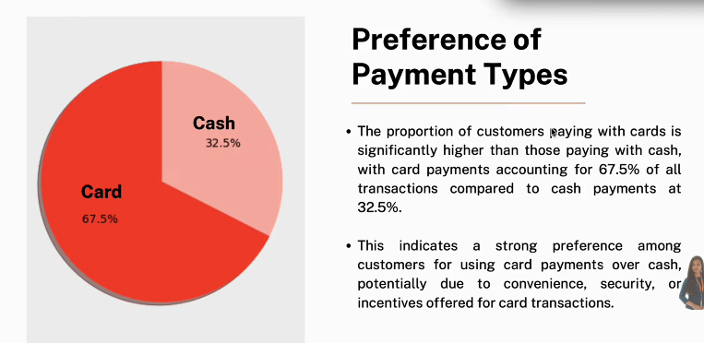

Slide 9
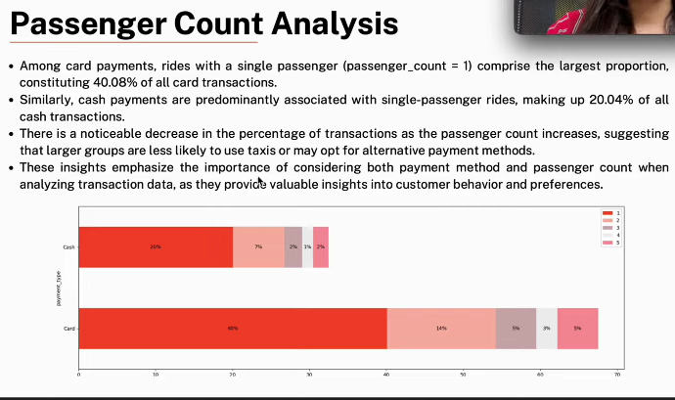

Slide 10
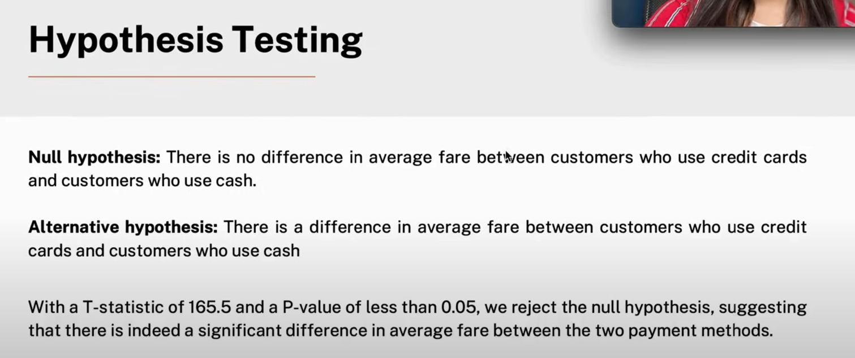

Slide 11
